Slide 1
Negative Powers as Reciprocals
Sarah Allott
8th September 2025

Slide 2
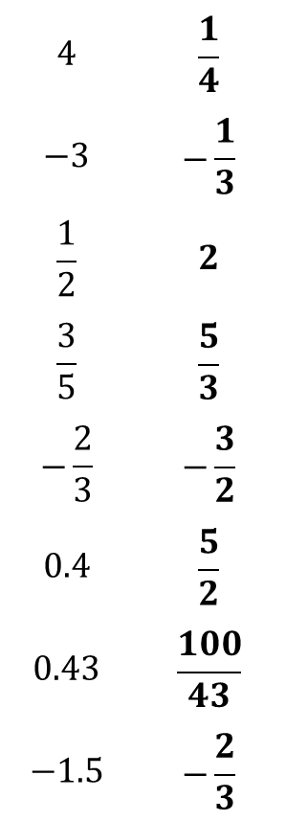
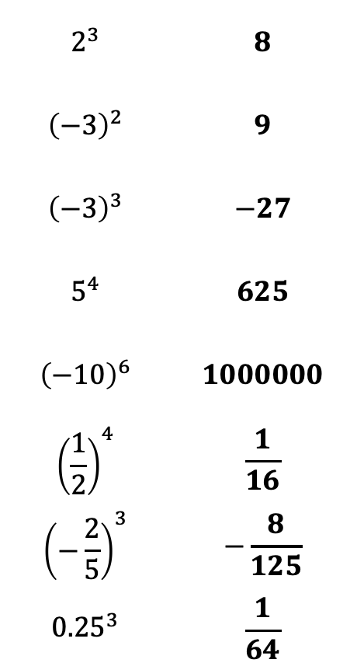
Prerequisite Knowledge Check
Show all solutions
11z
State the reciprocal of the following numbers:
2
Calculate:
?
$$2^{3}$$ | $$8$$
$${\left(−3\right)}^{2}$$ | $$9$$
$${\left(−3\right)}^{3}$$ | $$−27$$
$$5^{4}$$ | $$625$$
$${\left(−10\right)}^{6}$$ | $$1000000$$
$${\left(\frac{1}{2}\right)}^{4}$$ | $$\frac{1}{16}$$
$${\left(−\frac{2}{5}\right)}^{3}$$ | $$−\frac{8}{125}$$
$${0.25}^{3}$$ | $$\frac{1}{64}$$
$$4$$ | $$\frac{1}{4}$$
$$−3$$ | $$−\frac{1}{3}$$
$$\frac{1}{2}$$ | $$2$$
$$\frac{3}{5}$$ | $$\frac{5}{3}$$
$$−\frac{2}{3}$$ | $$−\frac{3}{2}$$
$$0.4$$ | $$\frac{5}{2}$$
$$0.43$$ | $$\frac{100}{43}$$
$$−1.5$$ | $$−\frac{2}{3}$$
a
a
?
?
?
b
b
?
c
?
c
?
d
?
d
?
?
e
e
?
?
f
f
?
?
g
g
?
?
h
h
Notes:
Prerequisite knowledge check to ensure the students have the skills to access this lesson.
Q1: finding the reciprocal of integers, fractions and decimals
Q2: raising integers, fractions and decimals to positive powers

Slide 3
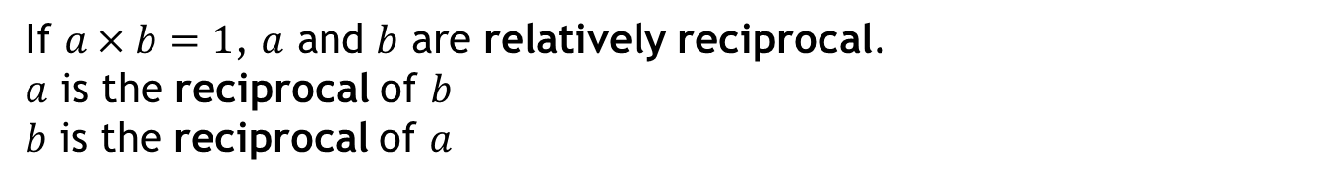
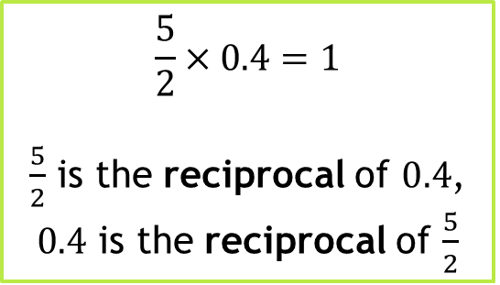
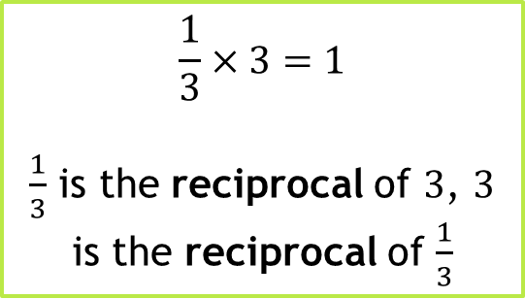
RECAP: Definition - The Reciprocal
The word reciprocal stems from the Latin reciprocus, meaning “returning the same way, alternating”.
If the product of two numbers equals 1, we say that they are relatively reciprocal.
If $a×b=1$, $a$ and $b$ are relatively reciprocal.
$a$ is the reciprocal of $b$
$b$ is the reciprocal of $a$
$$\frac{1}{3}×3=1$$
$\frac{1}{3}$ is the reciprocal of $3$, $3$ is the reciprocal of $\frac{1}{3}$
$$\frac{5}{2}×0.4=1$$
$\frac{5}{2}$ is the reciprocal of $0.4$, $0.4$ is the reciprocal of $\frac{5}{2}$
Notes:
Teacher Notes
Recap of the definition of a reciprocal using proper language.
Recap of the definition of a product may be needed

Slide 4














Quickfire Questions
Determine the reciprocals of the following numbers:
$$\frac{9}{4}$$
a
$$3$$
b
$$\frac{1}{3}$$
$$\frac{4}{9}$$
?
?
$$\frac{1}{7}$$
c
d
$$−2$$
?
$$−\frac{1}{2}$$
$$7$$
?
$$=\frac{16}{5}$$
$$3\frac{1}{5}$$
$$=\frac{11}{2}$$
e
f
$$5.5$$
Convert to an improper fraction first
$$\frac{5}{16}$$
$$\frac{2}{11}$$
?
Convert into a fraction first
?
Notes:
Teaching Notes
Quickfire questions to assess student understanding of reciprocals.
Click on green boxes to reveal answers.
Next question will appear 0.75s after previous answer revealed.

Slide 5

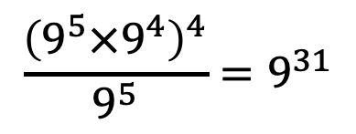


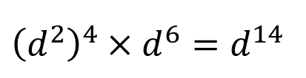
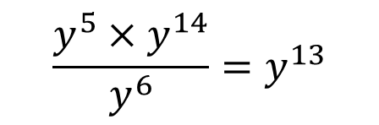
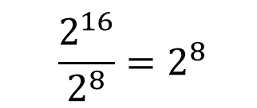



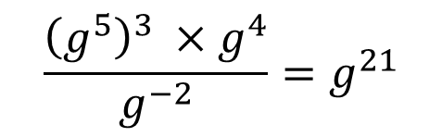



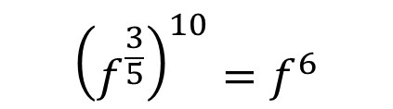
RECAP: Index Laws
$$a^{n}×a^{m}=a^{n+m}$$
$$a^{n}÷a^{m}=a^{n−m}$$
$${\left(a^{n}\right)}^{m}=a^{n×m}$$
Use index laws to fill in the gaps of the following calculations:
?
$$6^{8}÷6^{−3}=6^{11}$$
$$b^{5}×b^{−1}=b^{4}$$
?
?
1
$$5^{3}×5^{6}=5^{9}$$
5
9
?
?
$$\frac{y^{5}×y^{14}}{y^{6}}=y^{13}$$
?
$${\left(f^{\frac{3}{5}}\right)}^{10}=f^{6}$$
2
$$a^{7}÷a^{3}=a^{4}$$
6
10
$$\frac{{\left(g^{5}\right)}^{3} ×g^{4}}{g^{−2}}=g^{21}$$
$${\left(c^{3}\right)}^{2}=c^{6}$$
?
?
3
7
$${\left(3^{−7}\right)}^{2}=3^{−14}$$
11
?
$$\frac{2^{16}}{2^{8}}=2^{8}$$
$$\frac{{\left(9^{5}×9^{4}\right)}^{4}}{9^{5}}=9^{31}$$
$${\left(d^{2}\right)}^{4}×d^{6}=d^{14}$$
?
4
?
8
?
12
Notes:
Teaching Notes
Recap questions on index laws
Click on green boxes to reveal answers.
Next 4 questions will appear 0.75s after last in column answer revealed.

Slide 6









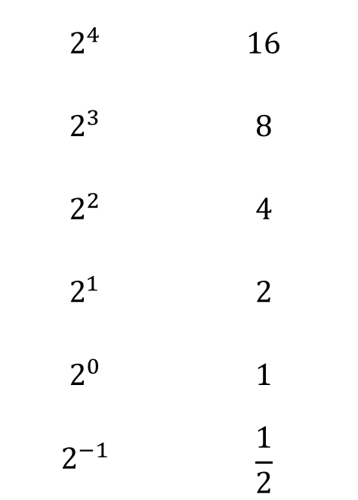
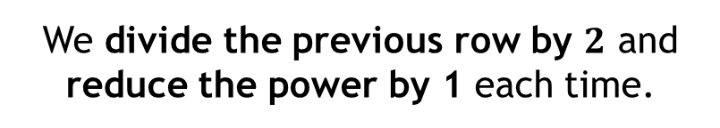

Pattern Spotting
$$2^{4}$$ | $$16$$
$$2^{3}$$ | $$8$$
$$2^{2}$$ | $$4$$
$$2^{1}$$ | $$2$$
$$2^{0}$$ | $$1$$
$$2^{−1}$$ | $$\frac{1}{2}$$
$$=$$
Here are the first four powers of $2$.
$$÷2$$
$$=$$
How does the value of each power change as we move down the list?
$$÷2$$
$$=$$
?
We divide the previous row by $2$ and reduce the power by 1 each time.
$$÷2$$
$$=$$
?
$$÷2$$
Click me to extend the list!
$$=$$
?
$$÷2$$
$$=$$
Let’s extend the table a little bit.
Fill in the blanks using the pattern you just spotted.
Notes:
Ask the students to spot the pattern of dividing by $2$ to get the next power down in the table.
Click the black box to reveal the non-positive section of the table (zero included). It may be worth revealing 0 and reminding the students that anything to the power of $0$ is $1$.

Slide 7
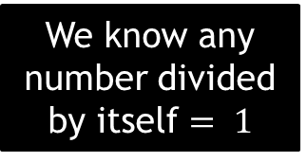
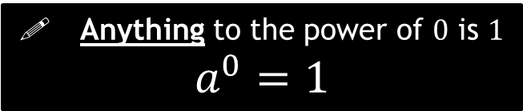
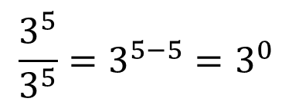
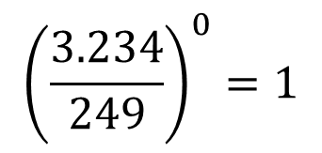



The Big Idea: Power of Zero
! Anything to the power of $0$ is $1$
$$a^{0}=1$$
Try the following in your calculators:
$${\left(\frac{3.234}{249}\right)}^{0}=1$$
$${15}^{0}=1$$
$${(−237)}^{0}=1$$
?
?
?
We can show this using our index laws…
$$\frac{3^{5}}{3^{5}}=3^{5−5}=3^{0}$$
We know any number divided by itself $= 1$
$$∴3^{0}=1$$
Notes:
Looking at the power of zero, and proving it with index laws.

Slide 8




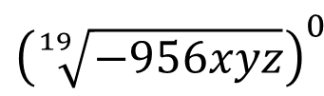










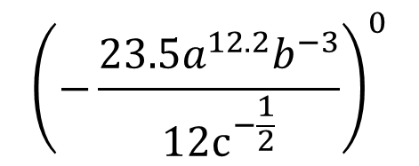



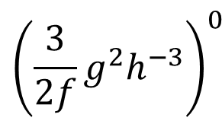
The Big Idea: Power of Zero
Determine the answers to the following calculations:
$${35}^{0}$$
$$x^{0}$$
$${\left(−7\right)}^{0}$$
?
$$=1$$
?
$$=1$$
?
$$=1$$
$${\left(12x^{7}y\right)}^{0}$$
?
$${83,729,837,392,823}^{0}$$
$$=1$$
$${272.42}^{0}$$
?
$$=1$$
?
$$=1$$
$${\left(a^{3}b^{2}\right)}^{0}$$
$${\left(\frac{3}{2f}g^{2}h^{−3}\right)}^{0}$$
$${\left(−\frac{23.5a^{12.2}b^{−3}}{12c^{−\frac{1}{2}}}\right)}^{0}$$
?
$$=1$$
?
$$=1$$
$${\left(\sqrt[19]{−956xyz}\right)}^{0}$$
?
$$=1$$
?
$$=1$$
Notes:
Teacher Notes
Quickfire questions to assess understanding that anything to the power of 0 is 1.

Slide 9







The Big Idea: Power of $−1$
We saw that $2^{−1}$is $\frac{1}{2}$ by spotting the pattern as powers reduced by $1$.
$$2^{1}$$ | $$2$$
$$2^{−1}$$ | $$\frac{1}{2}$$
What do you notice about values of $2^{1}$ and $2^{−1}$ ?
$$=$$
$2^{1}$ and $2^{−1}$ are relative reciprocals
$$=$$
We can show this is true using index laws:
$$2^{1}×2^{−1}=2^{0}=1$$
This is true for any value as
$$a^{1}×a^{−1}=a^{0}=1$$
We can use the fact that $a^{1}$ and $a^{−1}$ are reciprocals to determine any value to the power of $−1$
Notes:
Introduction to numbers to the power of -1 and relating this to reciprocals.

Slide 10





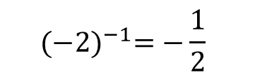



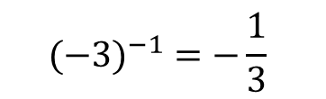
Calculate $7^{−1}$
Calculate $6^{−1}$
?
This means the reciprocal of $7$
i.e. $7×\boxed{}=1$
$$6^{−1}=\frac{1}{6}$$
$$7^{−1}=\frac{1}{7}$$
Calculate ${(−3)}^{−1}$
Calculate ${(−2)}^{−1}$
?
This means the reciprocal of $−3$
i.e. $−3×\boxed{}=1$
$${(−2)}^{−1}=−\frac{1}{2}$$
$${(−3)}^{−1} =−\frac{1}{3}$$
Notes:
Two examples, followed by two TYU questions.

Slide 11
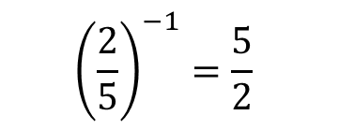
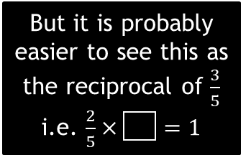




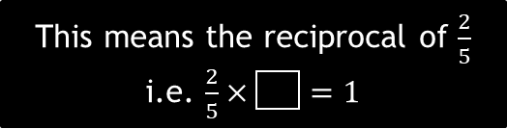

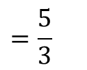



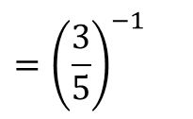
Calculate ${\left(\frac{2}{5}\right)}^{−1}$
Calculate ${\left(\frac{3}{2}\right)}^{−1}$
?
This means the reciprocal of $\frac{2}{5}$
i.e. $\frac{2}{5}×\boxed{}=1$
$${\left(\frac{3}{2}\right)}^{−1}=\frac{2}{3}$$
$${\left(\frac{2}{5}\right)}^{−1}=\frac{5}{2}$$
Calculate ${0.35}^{−1}$
Calculate ${0.6}^{−1}$
?
$${0.35}^{−1}={\left(\frac{35}{100}\right)}^{−1}$$
$$={\left(\frac{7}{20}\right)}^{−1}$$
$$=\frac{20}{7}=2\frac{6}{7}$$
This means the reciprocal of $0.6$
$$={\left(\frac{3}{5}\right)}^{−1}$$
But it is probably easier to see this as the reciprocal of $\frac{3}{5}$
i.e. $\frac{2}{5}×\boxed{}=1$
$${0.6}^{−1}$$
$$=\frac{5}{3}$$
Notes:
Two examples (one fraction and one decimal), followed by two TYU questions.

Slide 12








Quickfire Questions
a
What is $9^{−1}$?
b
State the value of ${(−10)}^{−1}$
?
?
$$\frac{1}{9}$$
$$−\frac{1}{10}$$
c
What is ${\left(\frac{2}{3}\right)}^{−1}$?
d
Calculate ${1.2}^{−1}$
?
$${\left(\frac{6}{5}\right)}^{−1}={\left(\frac{5}{6}\right)}^{1}$$
$$=\frac{5}{6}$$
?
$$\frac{3}{2}$$
Notes:
Four quickfire questions, non calculator, designed to be done on mini whiteboards.

Slide 13









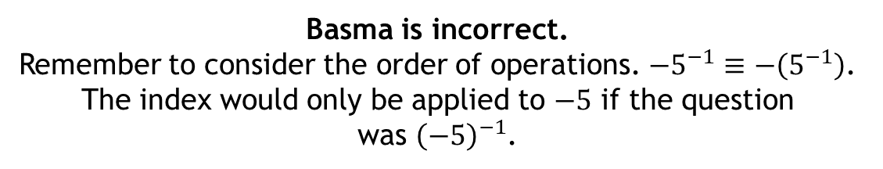

Who Is Correct? Why?
Calculate $−5^{−1}$
The reciprocal of $−5$ is $\frac{1}{−5}$.
Therefore $−5^{−1}=\frac{1}{−5}$
$$=−\frac{1}{5}$$
The reciprocal of $5$ is $\frac{1}{5}$.
Therefore $−\left(5^{−1}\right)=−\left(\frac{1}{5}\right)$
$$=−\frac{1}{5}$$
Both students got the same answer, which is correct.
However, one set of working out is incorrect. Why?
Basma
Nathan
?
Basma is incorrect.
Remember to consider the order of operations. $−5^{−1}≡−\left(5^{−1}\right)$. The index would only be applied to $−5$ if the question
was ${\left(−5\right)}^{−1}$.
Notes:
A very subtle ‘who is correct’.
Both students have the same answer, but one comes from incorrect working.
Basma is incorrect because she has assumed that the negative (or multiplication by $−1$) takes precedence over the power, whereas the power should be applied first, then the multiplication by $−1$.

Slide 14





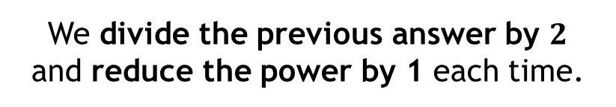
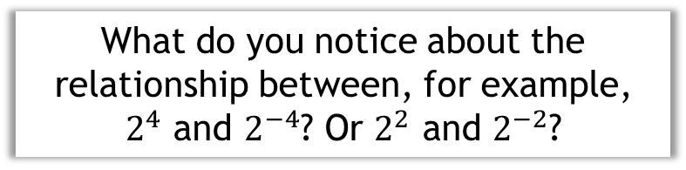


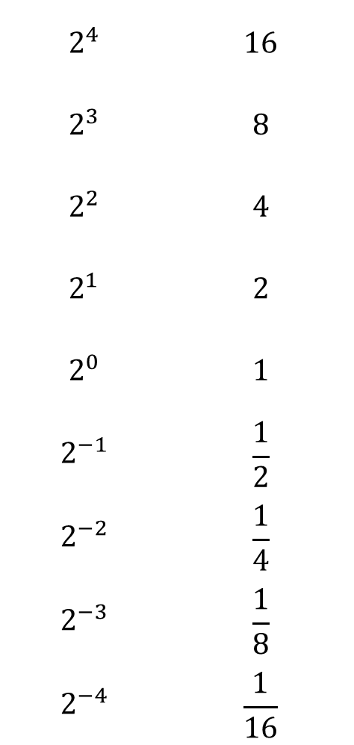


The Big Idea: Negative Indices
$$2^{4}$$ | $$16$$
$$2^{3}$$ | $$8$$
$$2^{2}$$ | $$4$$
$$2^{1}$$ | $$2$$
$$2^{0}$$ | $$1$$
$$2^{−1}$$ | $$\frac{1}{2}$$
$$2^{−2}$$ | $$\frac{1}{4}$$
$$2^{−3}$$ | $$\frac{1}{8}$$
$$2^{−4}$$ | $$\frac{1}{16}$$
$$=$$
Looking back at our powers of $2$.
$$÷2$$
$$=$$
How does the value of each power change as we move down the list?
$$÷2$$
$$=$$
?
We divide the previous answer by $2$ and reduce the power by 1 each time.
$$÷2$$
$$=$$
$$÷2$$
Click me to extend the list!
$$=$$
$$=$$
$$÷2$$
What do you notice about the relationship between, for example,
$2^{4}$ and $2^{−4}$? Or $2^{2}$ and $2^{−2}$?
$$=$$
?
$$÷2$$
?
The negative power is the reciprocal of the positive power.
$$=$$
?
$$÷2$$
?
This is true for any value as
$$a^{n}×a^{−n}=a^{0}=1$$
$$=$$
$$÷2$$
Notes:
Ask the students to spot the pattern of dividing by $2$ to get the next power down in the table.
When you click the green box next to $2^{−4}$ a final question is revealed, prompting the students to spot the relationship between positive and negative powers. This should lead to a discussion about the reciprocal, especially as it should be in their heads from the starter.

Slide 15
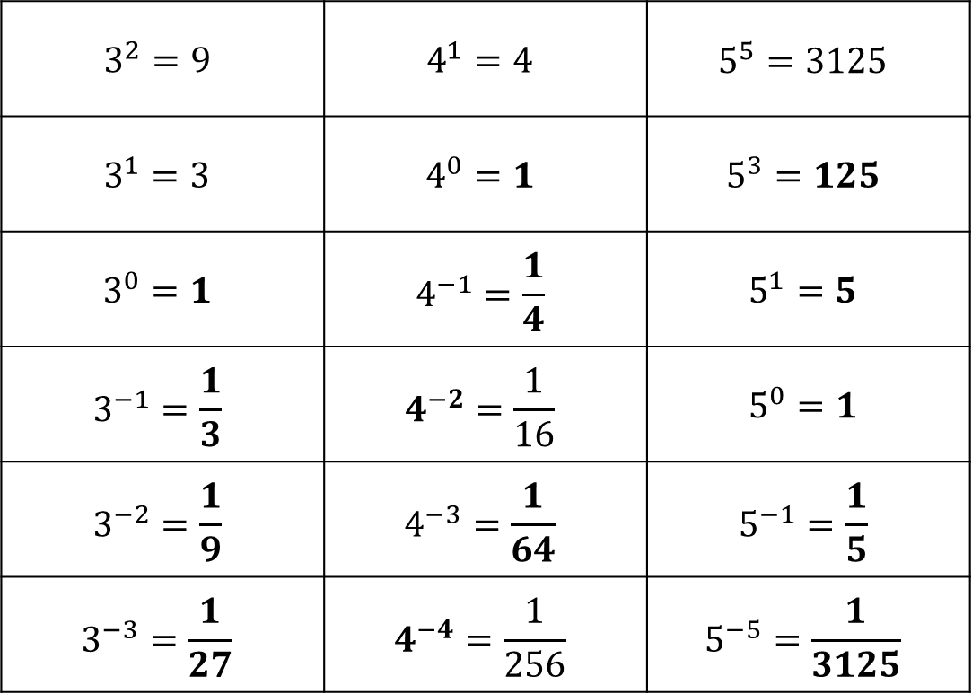
The Big Idea: Negative Indices
Show all solutions
Fill in the blanks in the table below.
$$3^{2}=9$$ | $$4^{1}=4$$ | $$5^{5}=3125$$
$$3^{1}=3$$ | $$4^{0}=1$$ | $$5^{3}=125$$
$$3^{0}=1$$ | $$4^{−1}=\frac{1}{4}$$ | $$5^{1}=5$$
$$3^{−1}=\frac{1}{3}$$ | $$4^{−2}=\frac{1}{16}$$ | $$5^{0}=1$$
$$3^{−2}=\frac{1}{9}$$ | $$4^{−3}=\frac{1}{64}$$ | $$5^{−1}=\frac{1}{5}$$
$$3^{−3}=\frac{1}{27}$$ | $$4^{−4}=\frac{1}{256}$$ | $$5^{−5}=\frac{1}{3125}$$
?
?
?
?
?
?
?
?
?
?
?
?
?
?
Notes:
Quickfire questions to test their understanding and consolidate the pattern spotting approach. Work from down the left most column first, then down the next column and so on as the questions are designed in this way to get more difficult.

Slide 16

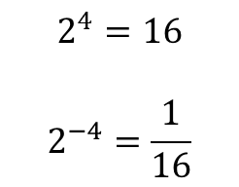

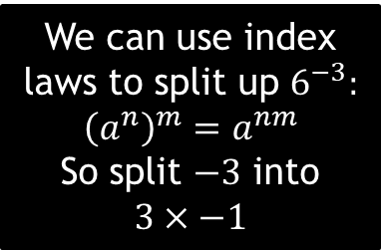

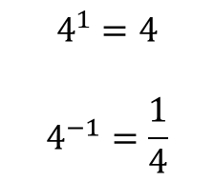
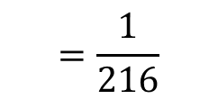
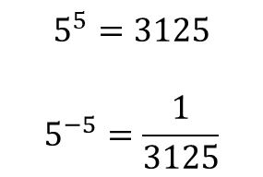

The Big Idea: Negative Indices
Earlier, we noticed that the negative power is the reciprocal of the positive power.
$$2^{4}=16$$
$$2^{−4}=\frac{1}{16}$$
$$5^{5}=3125$$
$$5^{−5}=\frac{1}{3125}$$
$$4^{1}=4$$
$$4^{−1}=\frac{1}{4}$$
How could we use this to calculate $6^{−3}$?
We can use index laws to split up $6^{−3}:$
$${\left(a^{n}\right)}^{m}=a^{nm}$$
So split $−3$ into
$$3×−1$$
$$6^{−3}={\left(6^{3}\right)}^{−1}$$
We know that $6^{3}=216$
$$={\left(216\right)}^{−1}$$
$$=\frac{1}{216}$$
The power of $−1$means to find the reciprocal

Slide 17




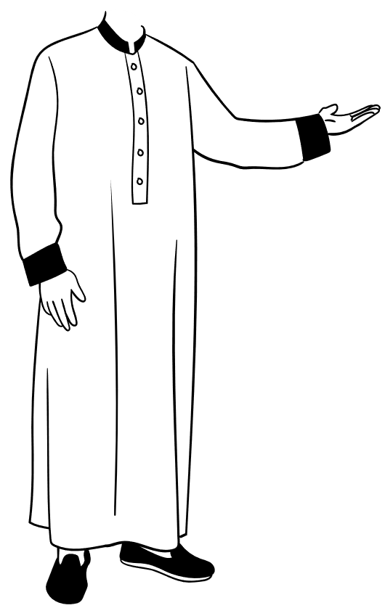



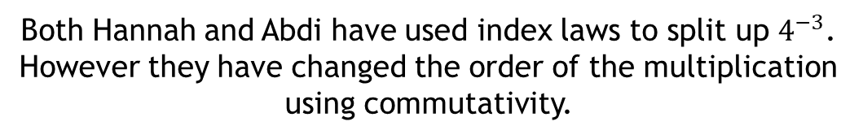







Method Comparison
Hannah and Abdi have both attempted a question on negative powers.
Both students are correct but have approached the question differently.
Evaluate $4^{−3}$
$$4^{−3}={\left(4^{3}\right)}^{−1}$$
$$4^{−3}={\left(4^{−1}\right)}^{3}$$
$$={\left(\frac{1}{4}\right)}^{3}$$
$$={\left(64\right)}^{−1}$$
$$=\frac{1}{64}$$
$$=\frac{1}{64}$$
What is the same? What is different?
Both Hannah and Abdi have used index laws to split up $4^{−3}$.
However they have changed the order of the multiplication using commutativity.
?
Hannah
Abdi
Which method do you prefer? Why?
Notes:
Hannah and Abdi have approached the question in slightly different ways.
Hannah has first split the powers to find $4^{3}$ first and then found the reciprocal of that.
Abdi has found the reciprocal of 4 first, and then cubed it.
Both are completely valid methods and either can be used to find the value of terms with a negative exponent.

Slide 18
















Calculate $7^{−2}$
Calculate $5^{−3}$
$7^{−2}={\left(7^{−1}\right)}^{2}$
Split the power into $−1×2$
?
$$5^{−3}={\left(5^{−1}\right)}^{3}$$
$$={\left(\frac{1}{5}\right)}^{3}$$
$$=\frac{1}{125}$$
$$5^{−3}={\left(5^{3}\right)}^{−1}$$
$={\left(125\right)}^{−1}$
$$=\frac{1}{125}$$
$$={\left(\frac{1}{7}\right)}^{2}$$
Find the reciprocal and then apply the positive power.
$$=\frac{1}{49}$$
Remember, you can use either Hannah or Abdi’s methods for these questions.
Calculate ${(−2)}^{−4}$
Calculate ${(−3)}^{−3}$
?
$${(−2)}^{−4}={\left(({−2)}^{−1}\right)}^{4}$$
$$={\left(−\frac{1}{2}\right)}^{4}$$
$$=\frac{1}{16}$$
$${(−2)}^{−4}={\left({\left(−2\right)}^{4}\right)}^{−1}$$
$={(16)}^{−1}$
$$=\frac{1}{16}$$
$${(−3)}^{−3}={\left(−3^{3}\right)}^{−1}$$
Split the power into $3×−1$
$$={\left(−27\right)}^{−1}$$
Apply the positive power and
then find the reciprocal
$$=−\frac{1}{27}$$
Notes:
Two examples, followed by two TYU questions.

Slide 19


















Calculate ${\left(\frac{2}{5}\right)}^{−2}$
Calculate ${\left(\frac{3}{2}\right)}^{−3}$
${\left(\frac{2}{5}\right)}^{−2}={\left({\left(\frac{2}{5}\right)}^{−1}\right)}^{2}$
$${\left(\frac{3}{2}\right)}^{−3}={\left({\left(\frac{3}{2}\right)}^{−1}\right)}^{3}$$
$$={\left(\frac{2}{3}\right)}^{3}=\frac{8}{27}$$
Split the power into $−1×2$
?
$$={\left(\frac{5}{2}\right)}^{2}$$
Find the reciprocal and then apply the positive power.
$$=\frac{25}{4}=6\frac{1}{4}$$
Calculate ${0.35}^{−2}$
Calculate ${0.6}^{−3}$
?
$${0.35}^{−2}={\left(\frac{35}{100}\right)}^{−2}={\left(\frac{7}{20}\right)}^{−2}$$
$${(0.6)}^{−3}={\left(\frac{3}{5}\right)}^{−3}$$
Split the power into $3×−1$
$$={\left({\left(\frac{7}{20}\right)}^{2}\right)}^{−1}$$
$${=\left({\left(\frac{3}{5}\right)}^{3}\right)}^{−1}$$
$$={\left(\frac{27}{125}\right)}^{−1}$$
It’s better to simplify here rather than at the end – you’d have to square 35 if you didn’t simplify first!
$$={\left(\frac{49}{400}\right)}^{−1}$$
Apply the positive power and then find the reciprocal
$$=\frac{125}{27}=4\frac{17}{27}$$
$$=\frac{400}{49}=8\frac{8}{49}$$
Notes:
Two examples (one fraction and one decimal), followed by two TYU questions.

Slide 20








Quickfire Questions
a
Calculate the value of ${10}^{−3}$
b
State the value of ${(−2)}^{−2}$
?
?
$$\frac{1}{1000}$$
$$\frac{1}{4}$$
c
What is ${\left(\frac{2}{7}\right)}^{−2}$?
d
Calculate ${0.25}^{−3}$
$${\left(\frac{1}{4}\right)}^{−3}={\left(4\right)}^{3}$$
$$=64$$
?
?
$$\frac{49}{4}$$
Notes:
Four quickfire questions, non calculator, designed to be done on mini whiteboards.

Slide 21





What is the value of $5^{−1}$?
$$−5$$
$$5$$
$$\frac{1}{5}$$
$$−\frac{1}{5}$$
Notes:
A: Common misconception, multiplying the index by the base.
B: Possible misread of the question – could have read $5^{1}$
C: Correct
D: Correctly remembered to do the reciprocal, but then written the answer as a negative, possibly similar thoughts to option A.

Slide 22





What is the value of $3^{−3}$?
$$\frac{1}{27}$$
$$27$$
$$\frac{1}{3}$$
$$−\frac{1}{27}$$
Notes:
A: Correct
B: Cubed $3$ rather than raising to a power of $−3$
C: Found the reciprocal, but has not applied the cube part of the power
D: Almost correct, included the negative too – common misconception

Slide 23





What is the value of $(−{100)}^{−1}$?
$$10$$
$$\frac{1}{100}$$
$$100$$
$$−\frac{1}{100}$$
Notes:
A: Incorrect
B: Remembered to do the reciprocal, but has forgotten the negative in this case. The reciprocal of $−100$is $−\frac{1}{100}$
C: Multiplied the index by the base – common misconception
D: Correct

Slide 24





What is the value of ${\left(\frac{1}{9}\right)}^{−2}$?
$$18$$
$$−\frac{1}{81}$$
$$\frac{1}{81}$$
$$81$$
Notes:
A: Found the reciprocal, but incorrectly squared $9$
B: Attempted to square the fraction, but has not found the reciprocal. Included the negative too.
C: Attempted to square the fraction, but has not found the reciprocal
D: Correct

Slide 25





What is the value of ${\left(\frac{2}{5}\right)}^{−1}$?
$$4$$
$$\frac{5}{2}$$
$$−\frac{2}{5}$$
$$5.2$$
Notes:
A: Incorrect, could have come from writing $\frac{2}{5}$ as a decimal and attempting to find the reciprocal from there.
B: Correct
C: Multiplied the index by the base – common misconception
D: Incorrect reciprocal

Slide 26





What is the value of ${0.25}^{−1}$?
$$\frac{1}{4}$$
$$−\frac{1}{4}$$
$$4$$
$$−4$$
Notes:
A: Converted to fraction, but not found the reciprocal
B: Converted to fraction and multiplied this by the index
C: Correct
D: Correctly found the reciprocal, but then multiplied this by the index

Slide 27





What is the value of ${0.3}^{0}$?
$$1$$
$$0.3$$
$$0$$
$$\frac{10}{3}$$
Notes:
A: Correct
B: Power of 0 ‘does nothing’
C: Power of 0 is 0 as there ‘are none’
D: Correctly found the reciprocal, assuming power of -1

Slide 28





What is the value of ${0.5}^{−3}$?
$$125$$
$$8$$
$$−\frac{1}{8}$$
$$\frac{1}{8}$$
Notes:
A: Cubed the $5$ rather than the reciprocal of $0.5$
B: Correct
C: Cubed the $0.5$, no reciprocal and has included the negative too
D: Cubed the $0.5$, no reciprocal

Slide 29





What is the value of ${\left(\frac{2}{3}\right)}^{−1}$?
$$\frac{2}{3}$$
$$−\frac{2}{3}$$
$$−1.5$$
$$\frac{3}{2}$$
Notes:
A: No reciprocal found
B: Multiplied index by the base – common misconception
C: Correctly found the reciprocal, but has included the negative too, common misconception
D: Correct

Slide 30





What is the value of ${0.4}^{−2}$?
$$16$$
$$0.16$$
$$\frac{25}{4}$$
$$6.25$$
Notes:
A: Squared the $4$, rather than the reciprocal of $0.4$
B: Squared the $0.4$ rather than squaring the reciprocal
C: Correct
D: Correct

Slide 31





What is the value of ${1.2}^{−3}$?
$$\frac{1}{3.6}$$
$$\frac{125}{216}$$
$$1.728$$
$$\frac{216}{125}$$
Notes:
A: Reciprocal of 1.2 multiplied by 3
B: Correct
C: 1.2 cubed, no reciprocal, written as a decimal
D: 1.2 cubed, no reciprocal, written as a fraction

Slide 32
































Exercise
(Available as a separate worksheet)
Show all solutions
1
State the reciprocals of:
2
Evaluate the following:
$$4^{−1}=\frac{1}{4}$$
?
$${\left(−3\right)}^{−1}=−\frac{1}{3}$$
$$\frac{1}{10}$$
a
?
b
$$6^{1}=6$$
c
?
a
$$10$$
?
$${\left(−4\right)}^{−1}=−\frac{1}{4}$$
$${\left(\frac{5}{2}\right)}^{−1}=\frac{2}{5}$$
$${0.7}^{−1}=\frac{10}{7}$$
$$−\frac{1}{15}$$
?
?
?
b
$$−15$$
?
d
e
f
$$\frac{1}{2}$$
?
c
$$2$$
3
Write down the value of the following:
$$\frac{3}{5}$$
$$\frac{5}{3}$$
$$2^{−3}=\frac{1}{8}$$
$$5^{−2}=\frac{1}{25}$$
$${\left(−2\right)}^{−3}=−\frac{1}{8}$$
d
?
?
b
?
?
a
c
$$−\frac{3}{4}$$
$$−\frac{4}{3}$$
e
?
$${\left(−5\right)}^{−2}=\frac{1}{25}$$
$${\left(\frac{3}{4}\right)}^{−2}=\frac{16}{9}$$
$${\left(\frac{1}{9}\right)}^{2}=\frac{1}{81}$$
d
?
e
?
f
?
$$0.5$$
?
f
$$2$$
$${\left(−\frac{1}{3}\right)}^{−3}=−27$$
$${0.32}^{−2}=\frac{625}{64}$$
$${1.2}^{−2}=\frac{25}{36}$$
g
?
h
?
i
?
$$0.1$$
?
g
$$10$$
$${\left(−0.09\right)}^{−3}=\frac{1000000}{729}$$
?
$$−\frac{20}{3}$$
j
$$−0.15$$
?
h

Slide 33

Exercise
(Available as a separate worksheet)
Show all solutions
4
Match the equivalent statements on the left to those on the right.
There are two blank spaces. Fill in the blanks.
$$3^{−1}$$ |  | $$\frac{25}{4}$$
$$2^{−2}$$ |  | $$\frac{1}{4}$$
$${\left(−4\right)}^{−2}$$ |  | $$\frac{10000}{27}$$
$${\left(\frac{2}{5}\right)}^{−2}$$ |  | $$27$$
$${0.3}^{−4}$$ |  | $$\frac{1}{3}$$
$${\left(\frac{1}{3}\right)}^{−3}$$ |  | $$−64$$
$${\left(−0.25\right)}^{−3}$$ |  | $$\frac{1}{16}$$
?
?
?
Notes:
Q1: Reciprocal questions
Q2: Standard questions based on K207a and K207b
Q3: Matching task
Q4: Reverse indices – find $x$

Slide 34







Exercise
(Available as a separate worksheet)
Show all solutions
5
Fill in the gaps:
$${\left(\frac{3}{4}\right)}^{−3}=\frac{64}{27}$$
$$\frac{1}{1000}={10}^{−3}$$
$$6^{−2}=\frac{1}{36}$$
?
?
?
a
b
c
N
Find the value of $x$.
?
$$x=−4$$
$$x^{2}={\left(−\frac{1}{2}\right)}^{x}$$
The best way to approach this to trial different values of $x$.
$${\left(−\frac{1}{2}\right)}^{−1}=2≠{\left(−1\right)}^{2}$$
$${\left(−\frac{1}{2}\right)}^{−2}=4≠{\left(−2\right)}^{2}$$
$${\left(−\frac{1}{2}\right)}^{−3}=8≠{\left(−3\right)}^{2}$$
$${\left(−\frac{1}{2}\right)}^{−4}=16={\left(−4\right)}^{2}$$
Notes:
Q1: Reciprocal questions
Q2: Standard questions based on K207a and K207b
Q3: Matching task

